Slide 1
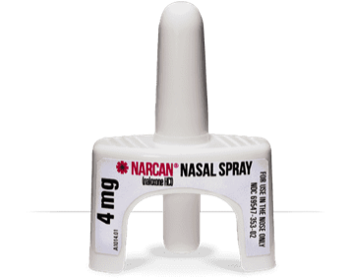
Opioid overdose deaths rates have increased by 21.5% from 2015 to 2016.
Naloxone can rapidly reverse the effect of opioid overdose and save lives.
Available without a prescription. Talk to a pharmacist about naloxone.

