Slide 1
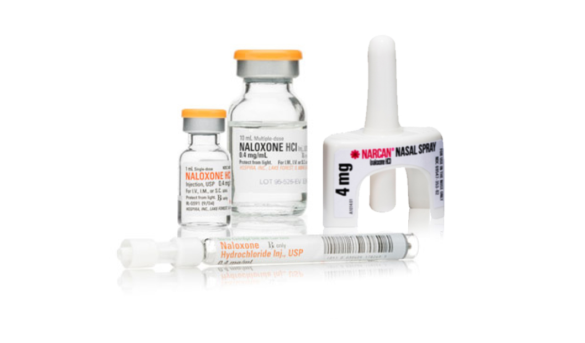
NALOXONE IS _______________
ANOTHER THANKSGIVING
A DIPLOMA
WALKING YOUR DAUGHTER DOWN
THE AISLE
A SECOND CHANCE
Drug overdose ranks as the leading cause of adult accidental death in the U.S.. With naloxone you have the power to counter the effects of opioid overdose.
Available without a prescription.
Talk to your pharmacist about naloxone.

