Slide 1
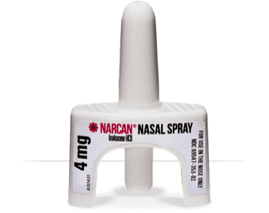
TALK TO YOUR PHARMACIST ABOUT NALOXONE.

