Slide 1
Maximizing OpiOid Safety with Naloxone (MOON) Study:
Academic Detailing
Spring 2017 RI
Jef Bratberg, PharmD, BCPS
Clinical Professor of Pharmacy Practice
University of Rhode Island College of Pharmacy

Slide 2
MOON Study Overview
Three year demonstration project funded by federal Agency for Healthcare Research & Quality (AHRQ)
Purpose
  Reduce harm from opioid-related adverse events
  Safer use of opioids and increase patient awareness
  Increased access to naloxone as a rescue medication
  Approach
  Public health campaign on opioid safety, overdose awareness, and the distribution of naloxone
  Pharmacy focus to increase naloxone distribution, patient safety education, and strengthen current systems such as the Prescription Drug Monitoring Program (PDMP)
  Drug Monitoring Program (PDMP)

Slide 3
Agenda
Define “academic detailing”
Review
  Steps for engaging the pharmacist
  Pharmacist guide
  Pharmacy patient handouts
  Recovery/treatment resource materials
  Steps for naloxone administration
  Role play scenarios
    High-dose opioid patient
    Opioid + benzodiazepine patient
    Caregiver naloxone request

Slide 4
Academic detailing:
Improving Patient Care
25 years of countering pharmaceutical detailing
Successful implementation involves
  Use interactive peer-to-peer dialogue
  Possess clear objectives
  Establish and maintain credibility
  Use concise, engaging materials
  Repetition, repetition, repetition
http://www.alosafoundation.org/academic-detailing/
Psychiatr Rehabil J. 2011 Winter;34(3):257-9. doi: 10.2975/34.3.2011.257.259.
J Pharm Practice 2015;28(2):162-165.

Slide 5
Objectives
Provide academic detailing to pharmacists about naloxone
  Increase prescribing and dispensing to patients with risk factors
  Increase access and dispensing to friends, family, and caregivers of patients
Components of our academic detailing (AD)
  Pharmacist guide
  Recovery resource materials
  Steps for naloxone administration (state-specific)
  Role playing (if time)

Slide 6
Steps for Engaging the Pharmacist in Academic Detailing
Call the pharmacy and set up meeting
Introduce yourself in person
Ask the pharmacist how much time they have
Ask about naloxone dispensing
Introduce the Guide for Pharmacists Dispensing
Naloxone to Patients
Present treatment resources for patient
Role Play patient or caregiver encounter (if time)

Slide 7
Steps for Engaging the Pharmacist:
1. Call the Pharmacy
CALL THE PHARMACY before showing up, and ask to speak with a pharmacist/pharmacy manager. INTRODUCE YOURSELF and ask if they have a few minutes to review materials to help them with naloxone dispensing.
“I am part of the town overdose prevention coalition, working with the Massachusetts Department of Public Health, to reduce community overdoses.” OR
“I am calling to talk with you about some new ways that you can offer naloxone rescue kits to your community members at the pharmacy.” OR
“Your pharmacy has a standing order for naloxone rescue kits and I want to help you implement this program.”

Slide 8
Steps for Engaging the Pharmacist:
2. Introduce Yourself
At the time arranged, approach the counter and ask to speak to the pharmacist/pharmacy manager. Introduce yourself (again) and provide materials.
“Hi, I am a (Pharmacy student / MOON research team / community coalition / prevention coalition member), may I speak to the pharmacy manager or the pharmacist? I would like to spend a few minutes reviewing this Guide for Pharmacists Dispensing Naloxone to Patients and talking about how you can help save lives here in [TOWN/CITY] with naloxone.
If asked if you represent a company/pharmaceutical product: I'm a volunteer: I'm not here representing any company or products, I'm here because I live/work here in RI/MA and I am part of a community prevention coalition working with your pharmacy to increase naloxone distribution into our community.”
If they don’t have time when you plan to arrive, ask when they would have time to talk and schedule an appointment.

Slide 9
Steps for Engaging the Pharmacist:
3. Ask the Pharmacist for their Time
ASK THE PHARMACIST HOW MUCH TIME THEY CAN SPARE: The amount of time they offer determines if you will only review the guide, or be able to also include a role play scenario.
“Thank you for talking to me, I want to make sure that we have enough time to review this guide and answer your questions. How much time do you have right now?”
If the pharmacist does not have ANY time right now, offer to wait up to 15 minutes or schedule a time when you can return to review the materials.
If the pharmacist does have time, proceed with the detailing.

Slide 10
Steps for Engaging the Pharmacist:
4. Ask About Naloxone
Pharmacists who have dispensed naloxone may want to more quickly review the process, while pharmacists who haven’t dispensed naloxone may have more questions and need more time to digest the information.
Have you ever dispensed naloxone?

Slide 11
Steps for Engaging the Pharmacist:
4. Ask About Naloxone
IF YES: Quickly review the guide, and attempt to complete a role-play scenario AT THIS VISIT.
Can you tell me how that went for you? What went well and what was a challenge?
As we go through the Guide, think about your experience and how the guide will help you the next time that you dispense naloxone.
Then, you can practice counseling me on overdose response and naloxone using the guide.”
IF NO: Review each section of the guide, asking questions to assess understanding and to clarify anything in the section that is unclear.
“Well, what do you know about dispensing naloxone at the pharmacy?
We feel that this guide will help you recommend naloxone and deliver overdose response education to patients.

Slide 12
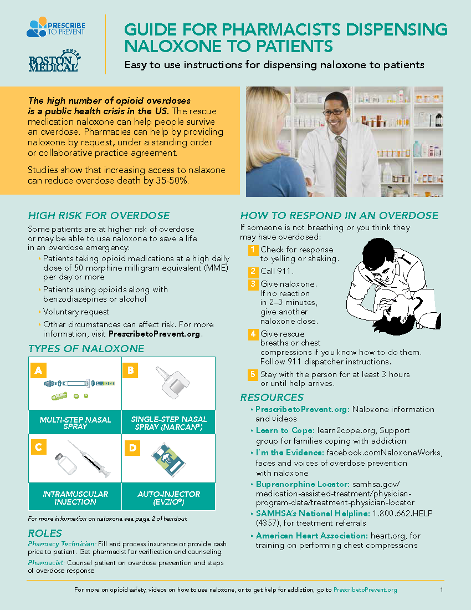
Steps for Engaging the Pharmacist:
5. Introduce the Guide
Briefly explain the importance of the guide and personal significance to you.
  Pharmacies are an important source for this lifesaving medication
  Studies show that greater naloxone access saves lives
  The CDC recommends providing naloxone to prevent overdose
Studies show that increasing access to naloxone can reduce overdose death by 35-50%

Slide 13
Side 1: Patients and Staff

Slide 14
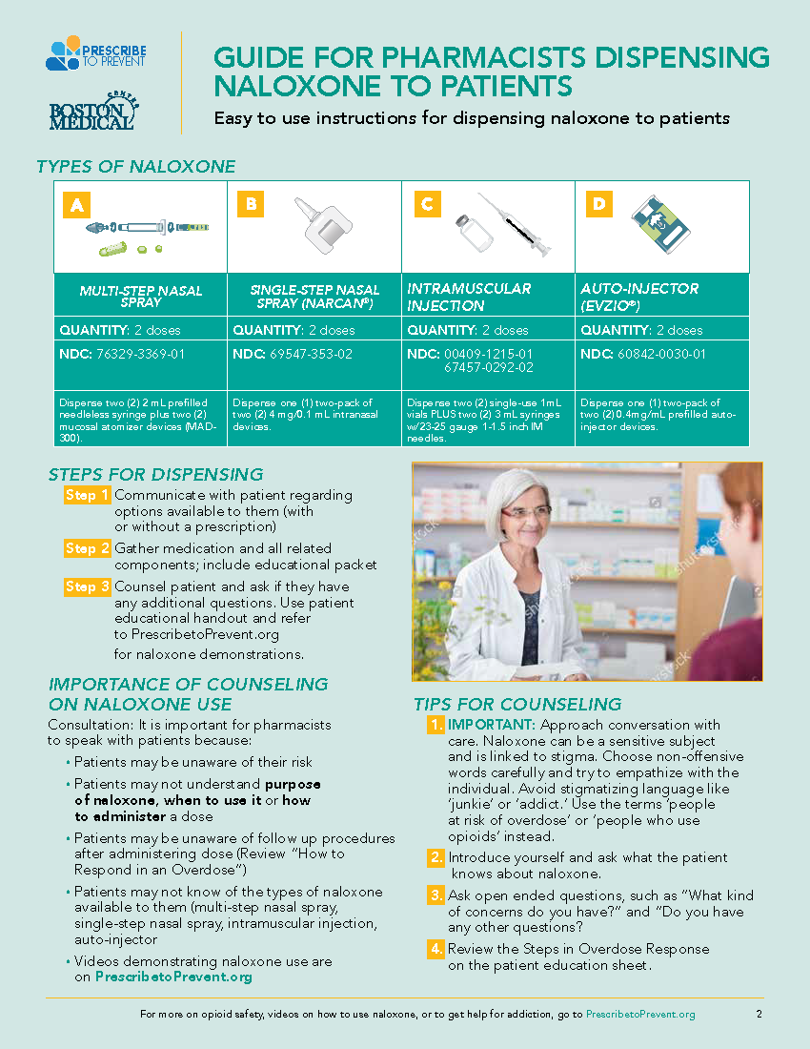
Side 2: Pharmacists

Slide 15
“What fraction of your patients are at high risk of overdose (take high dose opioids, take opioids with benzodiazepines, or are caregivers of patients at high risk of overdose?)”
Up to 1 in 10 of ALL prescriptions dispensed are for opioids
Of these 10, at least 1 is also dispensed with a benzodiazepine
Most combinations are prescribed by the same provider on the same day

Slide 16
“Are you familiar with the types of naloxone?’
Explain 2 dose minimum for each formulation
  2 pink boxes + 2 nose cones
  2 vials + 2 IM (1”) syringes
  Brands (Narcan and Evzio) each contain 2 doses in their boxes
The multi-step intranasal (“Pink Box”) is labeled for IV, IM, or SC but is used intranasally with white atomizer (“nose cone”)
Recommend forms available by standing order and/or corporate policy

Slide 17
“Are you familiar with steps to tell patients how to respond to an overdose?”

Slide 18
“Are you familiar with steps to tell patients how to respond to an overdose?”
Emphasize not just assembly and administration, but also:
  Recognition
  Call 911
  CPR/rescue breaths
  What happens after naloxone administration
    Rescue position
    Stay with patient
Patient Handouts

Slide 19
Rhode Island Pharmacy Naloxone Pamphlet

Slide 20
Intramuscular Naloxone Administration

Slide 21
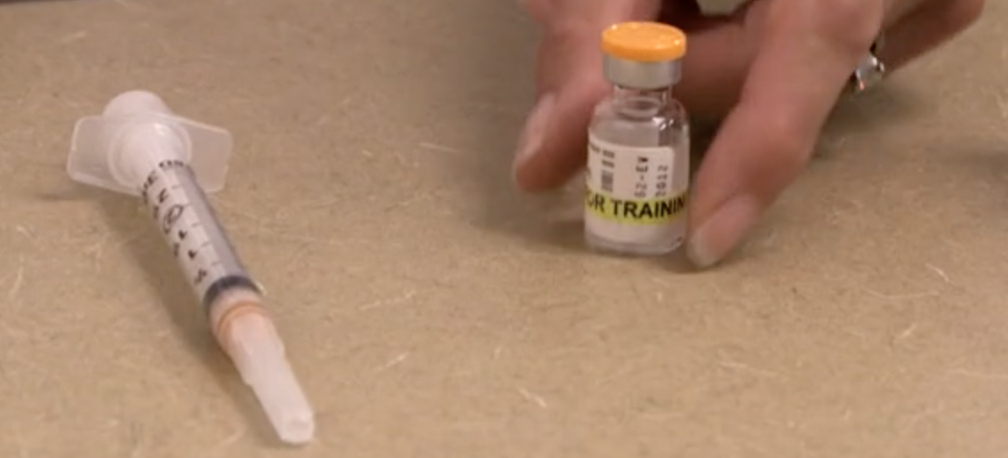
Step 1: Prepare one dose
One 1” needle with syringe /one vial

Slide 22
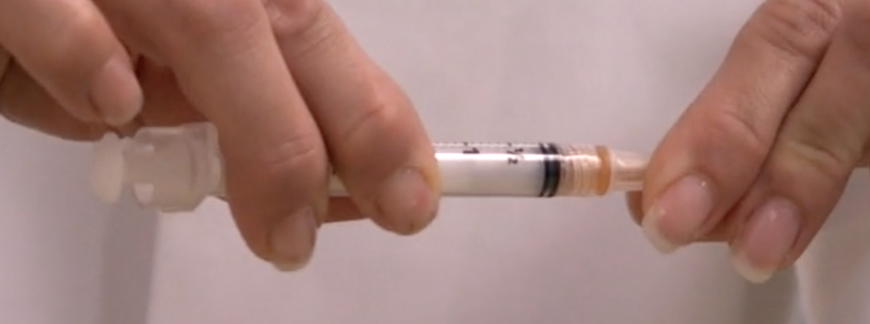
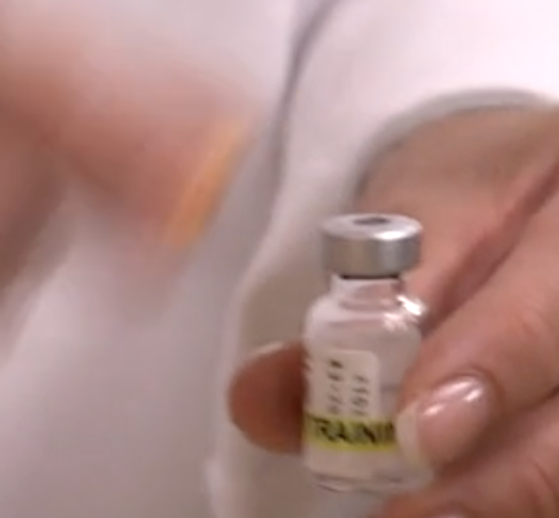
Step 2:
Remove caps from vial and needle

Slide 23
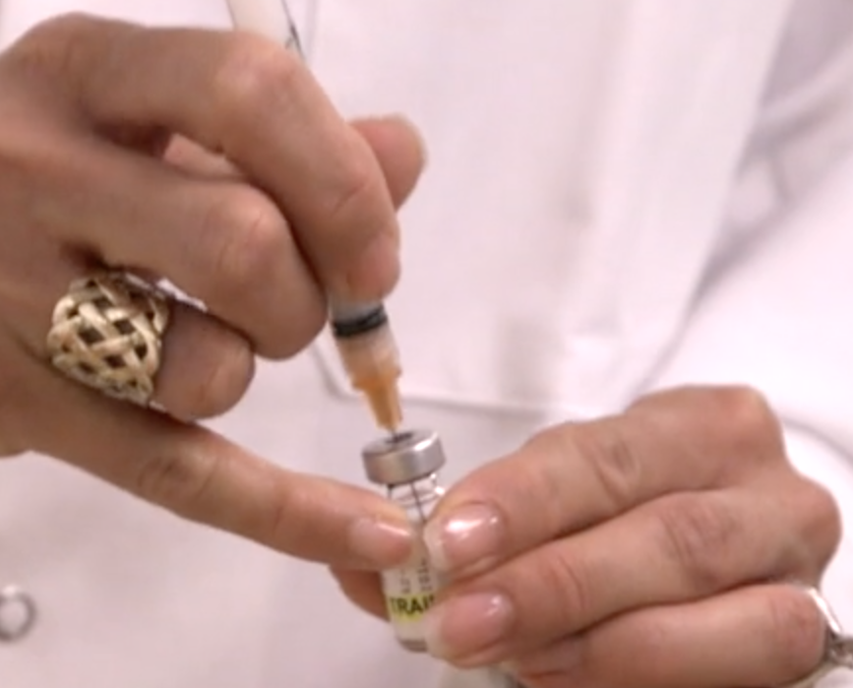
Step 3: Insert needle into vial

Slide 24
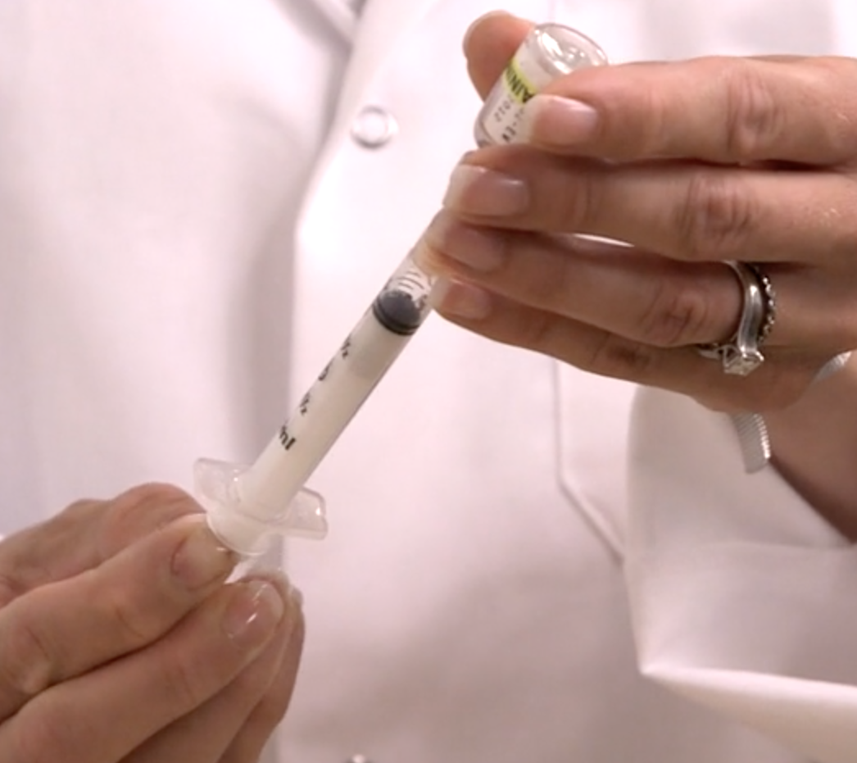
Step 4:
Draw entire vial contents into syringe

Slide 25
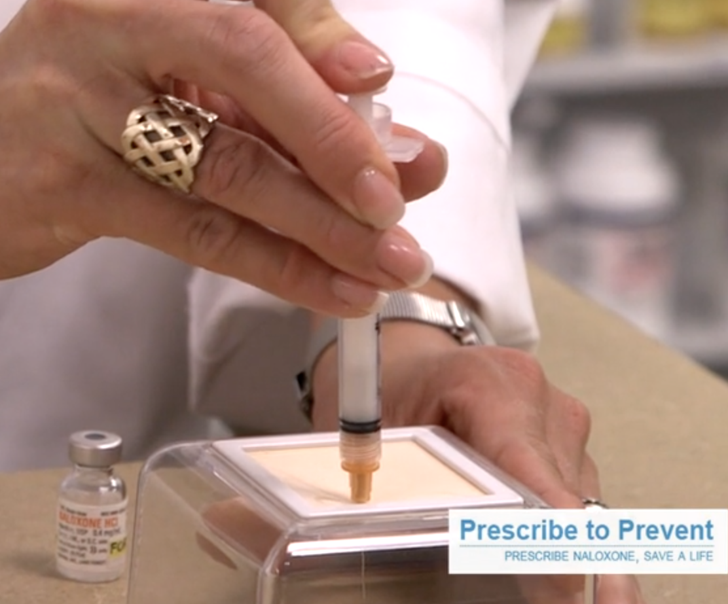
Step 5: Inject contents of syringe into thigh or shoulder muscle

Slide 26
Multi-step Intranasal Naloxone Administration

Slide 27
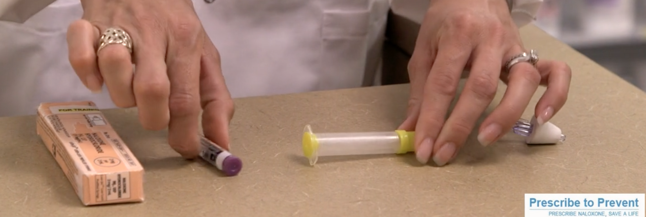
Step 1: Prepare Contents –
“Pink box” contains glass vial & plastic syringe; white nose cone packaged separately

Slide 28
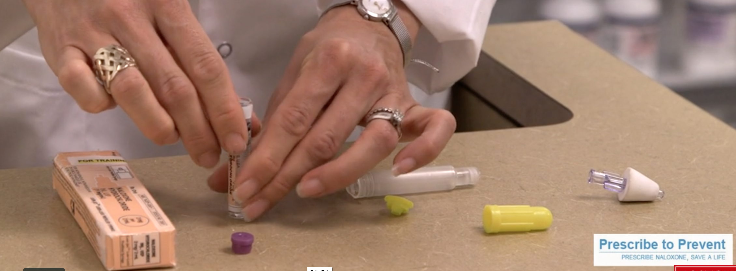
Step 2: Remove yellow and purple caps from glass vial and plastic syringe

Slide 29
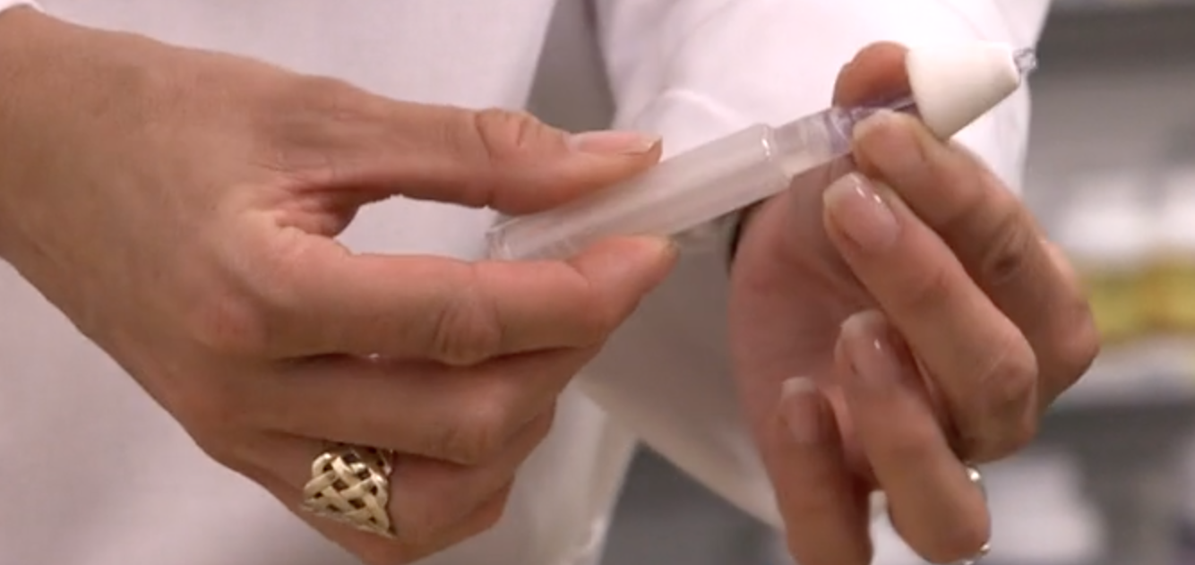
Step 3: Screw the nose cone onto the top of the plastic syringe

Slide 30
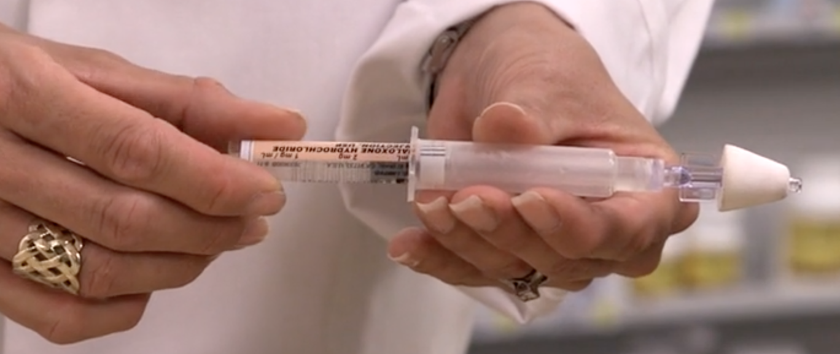
Step 4: carefully screw glass vial into the bottom of the plastic syringe

Slide 31
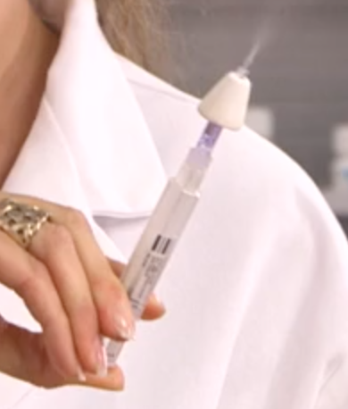
Step 5: Spray half of the syringe contents into one nostril and the rest into the other nostril

Slide 32
“Are you familiar with any of these resources?
Videos on prescribetoprevent.org for pharmacists AND patients
National treatment referral helpline

Slide 33
“Why is it important for pharmacists to counsel patients about naloxone?”
Patients need to know about all risks of opioids
Pharmacists can counsel patients on all potential bad reactions like constipation AND breathing problems from opioids
Breathing problems are worsened when opioids are combined with other medications like benzodiazepines or alcohol

Slide 34
Naloxone Conversation Starters for the Pharmacist

Slide 35
Naloxone Conversation Starters for the Pharmacist
“Opioids can cause bad reactions that make your breathing slow or even stop. This can happen if your body can’t handle the opioids you take that day, or if you take opioids with alcohol or other drugs. Naloxone is a lifesaver, just like a seatbelt or a fire extinguisher.”
”These medications can be helpful but have a range of side effects, like slowing down or even stopping breathing completely. “Naloxone can help if this happens by restoring breathing.”
“Opioid medications increase the risk of breathing emergency for the person who takes the opioid and anyone in their household. Naloxone is needed in case of emergency.”
“Let’s keep you and your family as healthy as possible with these medications in your house. Just in case, get naloxone.”

Slide 36
Steps for Engaging the Pharmacist:
6. Additional Patient Resources
Give treatment resource materials to pharmacist.
Tell the pharmacist that they can order additional resources at no cost (MA Wallet Card – bit.ly/MATreatment; RI “Addiction is a Disease..” - 401-462-4680)
“Do you dispense buprenorphine/naloxone?”
“Studies show that evidence-based drug treatment, especially buprenorphine and methadone, SAVES LIVES, but people may not know where to turn, so I’m leaving these materials with you today.”
“When people are treated with buprenorphine and methadone, their risk of death goes down, they return to work and to their families, and they have a better quality of life. We see this in the US, and across the world.

Slide 37
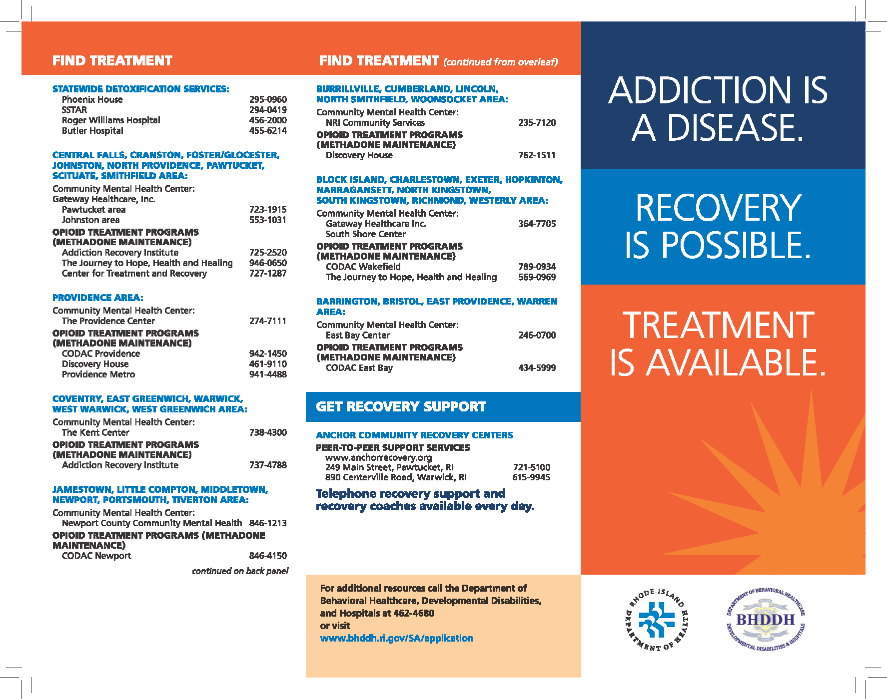
RI Resources
Order more at:
401-462-4680

Slide 38
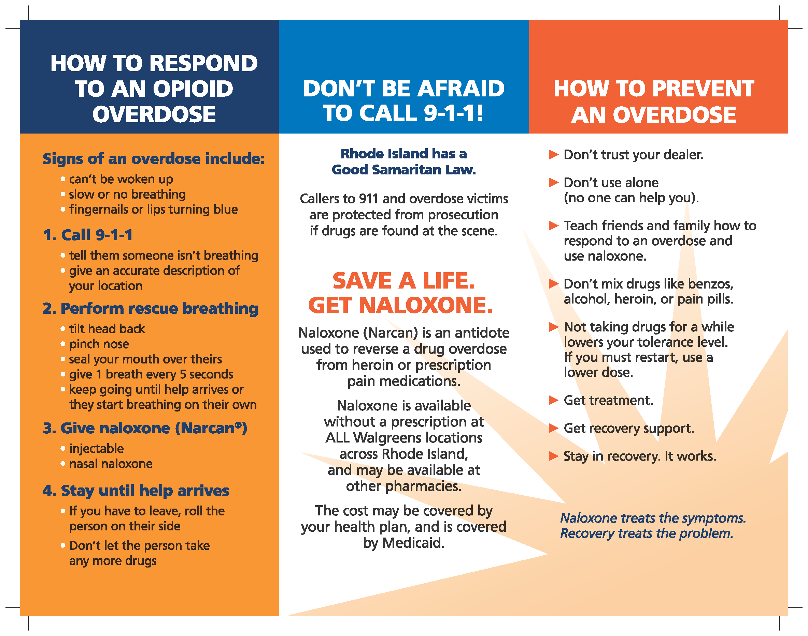
RI Resources
Order more at:
401-462-4680

Slide 39
Steps for Engaging the Pharmacist:
7. Ask to Practice Offer
ASK IF THE PHARMACIST STILL HAS TIME and wishes to practice.
IF NO OR LIMITED TIME: Schedule a time to return for practice OR
Offer to practice as a patient picking up an opioid prescription or an opioid and benzodiazepine prescriptions and the pharmacist can practice just recommending naloxone to you.
IF NOT INTERESTED: End visit by thanking them again for their time, tell them that they can contact Jef Bratberg with any questions at 401-419-6303, jefbratberg@uri.edu
“Thank you for taking time to review the guide with me. Do you have time to practice using the guide with me as a patient? I can also come back to role play another time, as well.”
“No problem, I completely understand. When would be the best time to come back and practice with you?”
OR
“I understand you only have a minute. Could we practice how you would recommend naloxone to a patient?”
“Ok! I hope you find the guide useful, and if you have any questions, please contact Jef Bratberg (hand card). He will be calling the pharmacy to follow-up.”

Slide 40
Steps for Engaging the Pharmacist:
Role Play Scenarios
Choose one of the scenarios below:
Co-prescription of opioid and benzodiazepine
“Hi, I’m here to pick up my oxycodone and alprazolam.” OR
“Hi, I’m here to pick up my pain and anxiety pills.”
High (> 50) MME
“Hi, I’m here to pick up my Oxycontin.”
Patient/caregiver request
“Hi, I’d like to pick up some naloxone. Someone in my household is at risk.”

Slide 41
Steps for Engaging the Pharmacist:
Role Play Actions
Choose a naloxone product for counseling when the pharmacist offers the choices.
Must receive a naloxone patient education handout.
DOUBLE TEACH-BACK: Be sure you use a teach back process with the pharmacist and then the pharmacist uses a teach-back process with you (as the role-playing patient).
Essential for practicing as patients at risk, as they will have to practice teaching their caregivers these steps using the materials you give them.

Slide 42
Steps for Engaging the Pharmacist:
Role Play Feedback
Give brief feedback on practice, review guide with pharmacist to emphasize any missed key points. Did the pharmacist -
  Review all steps for naloxone response
    Purpose
    When to use
    How to administer
    What to expect after administering
  Use language appropriate for all patients
  Maintain eye contact
  Use a teachback technique
  Recommend treatment and video resources

Slide 43
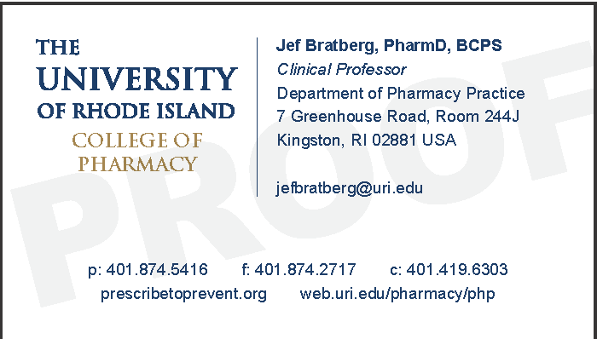
Steps for Engaging the Pharmacist:
8. End Visit
Thank the pharmacist for their time!
They can contact Jef Bratberg from URI anytime by phone or email with questions
401-419-6303
jefbratberg@uri.edu
Please leave a card

